Slide 1
6.852: Distributed Algorithms Fall, 2015
Lecture 2

Slide 2
Today’s plan
Leader election in a synchronous ring:
Lower bound for comparison-based algorithms.
Basic computation in general synchronous networks:
Leader election
Breadth-first search
Broadcast and convergecast
Shortest paths (Bellman-Ford)
Reading: Sections 3.6, 4.1-4-3
Next time:
Shortest paths, continued
Minimum Spanning Tree
Maximal Independent Set
Reading: Sections 4.3-4.5, related papers (see last slide)
Notes:
Remind people that the slides will be posted on Stellar.

Slide 3
Leader Election in a Synchronous Ring

Slide 4
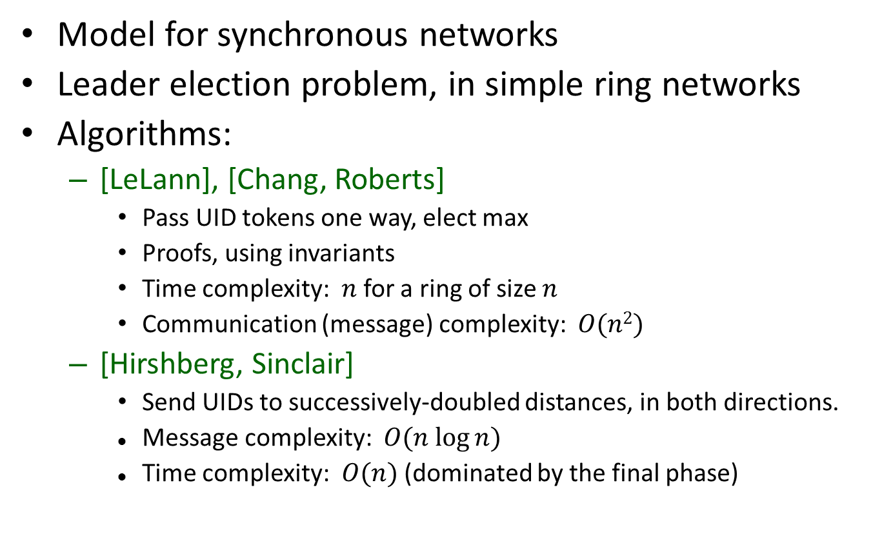
Last time
Model for synchronous networks
Leader election problem, in simple ring networks
Algorithms:
[LeLann], [Chang, Roberts]
Pass UID tokens one way, elect max
Proofs, using invariants
Time complexity: $n$ for a ring of size $n$
Communication (message) complexity: $O(n2)$
[Hirshberg, Sinclair]
Send UIDs to successively-doubled distances, in both directions.
Message complexity: $O(n log⁡n)$
Time complexity: $O(n)$ (dominated by the final phase)

Slide 5
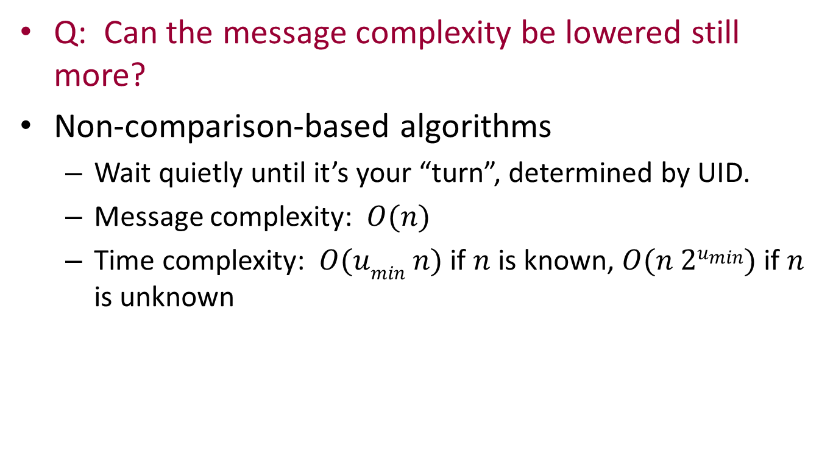
Last time
Q: Can the message complexity be lowered still more?
Non-comparison-based algorithms
Wait quietly until it’s your “turn”, determined by UID.
Message complexity: $O(n)$
Time complexity: $O(umin n)$ if $n$ is known, $O(n 2umin)$if $n$ is unknown

Slide 6
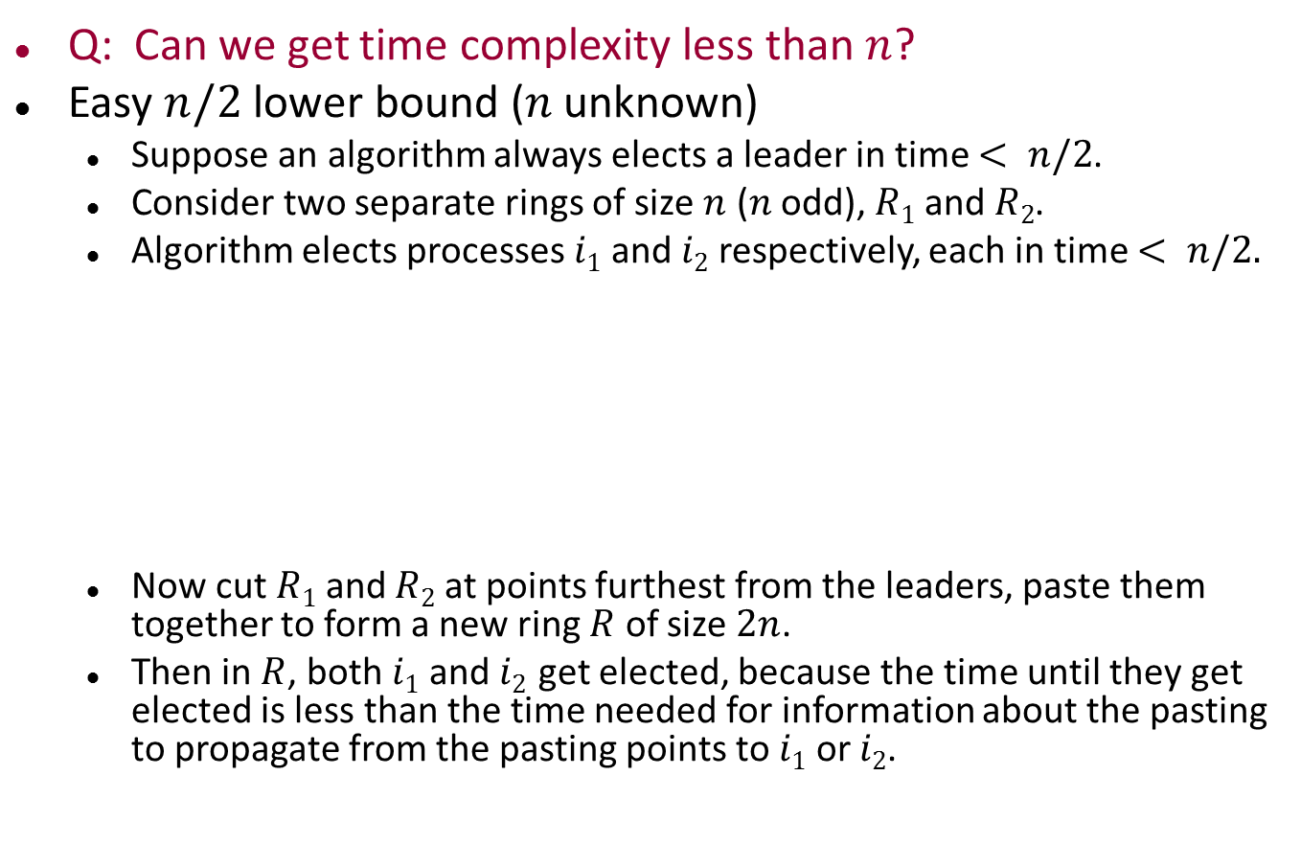
Lower bounds for leader election
Q: Can we get time complexity less than $n$?
Easy $n/2$ lower bound ($n$unknown)
Suppose an algorithm always elects a leader in time $< n/2$.
Consider two separate rings of size $n$ ($n$ odd), $R1$ and $R2$.
Algorithm elects processes $i1$ and $i2$ respectively, each in time $< n/2.$
Now cut $R1$ and $R2$ at points furthest from the leaders, paste them together to form a new ring $R$ of size $2n$.
Then in $R$, both $i1$ and $i2$get elected, because the time until they get elected is less than the time needed for information about the pasting to propagate from the pasting points to $i1$ or $i2$.
i₁
R₁
R₂
i₂
i₁
R
i₂
Notes:
This lower bound idea is for any type of UID space, UIDs accessible using any operations.
Choose these two rings to have disjoint sets of UIDs.
This argument is somewhat informal.
Next we will see a more formal treatment of a related result---a lower bound on the number of (single-hop) messages.

Slide 7
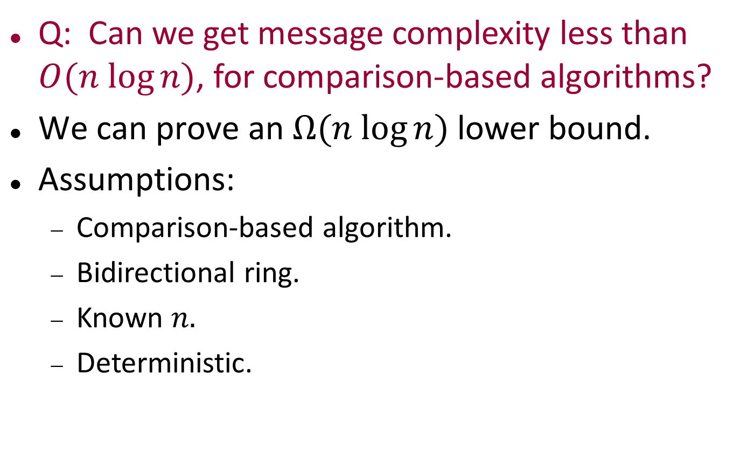
Lower bounds for leader election
Q: Can we get message complexity less than $O(n log⁡n)$, for comparison-based algorithms?
$\text{We} \text{can} \text{prove} \text{an} Ω(n log⁡n)$lower bound.
Assumptions:
Comparison-based algorithm.
Bidirectional ring.
Known $n.$
Deterministic.
Notes:
This argument is more difficult.

Slide 8
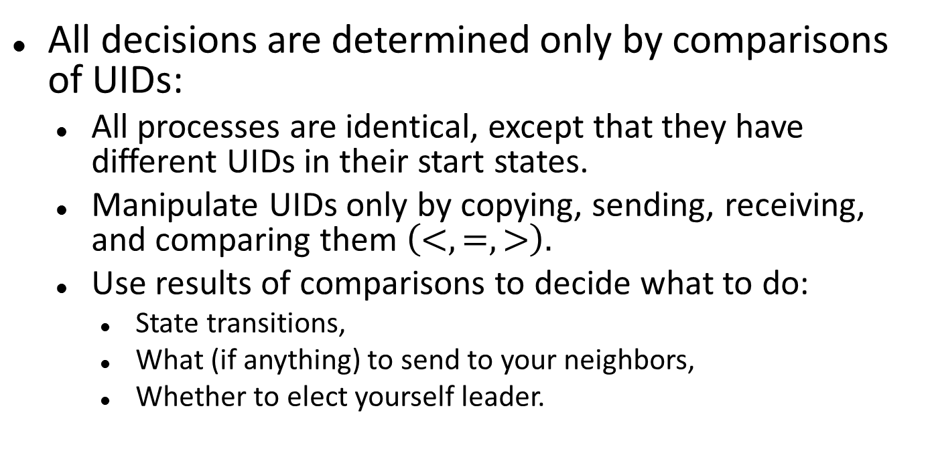
Comparison-based algorithms
All decisions are determined only by comparisons of UIDs:
All processes are identical, except that they have different UIDs in their start states.
Manipulate UIDs only by copying, sending, receiving, and comparing them $\left(<, =, >\right).$
Use results of comparisons to decide what to do:
State transitions,
What (if anything) to send to your neighbors,
Whether to elect yourself leader.
Notes:
Formalized a little better in book; done more carefully in research paper.
In terms of a LISP S-expression representation of the states, which explicitly keeps track of the process’s history, including messages received.

Slide 9
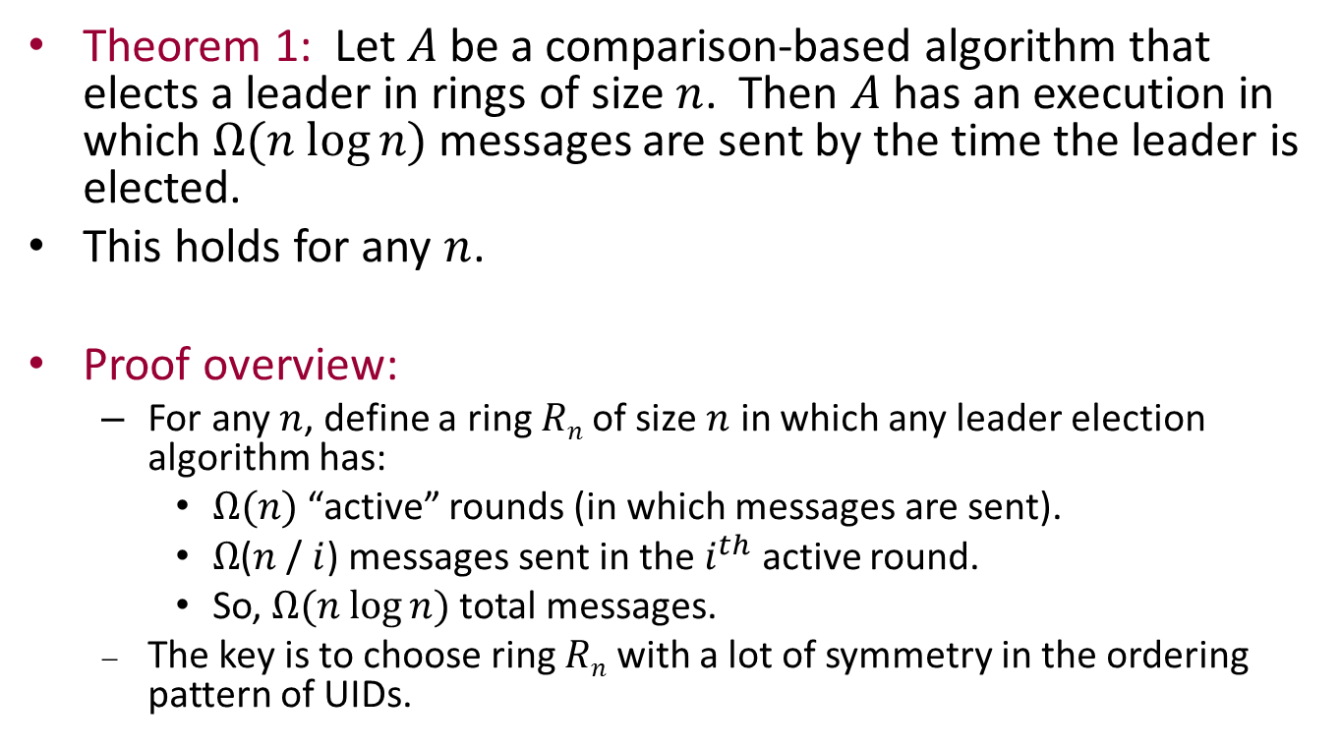
Lower bound theorem
Theorem 1: Let $A$ be a comparison-based algorithm that elects a leader in rings of size $n$. Then $A$ has an execution in which $Ω(n log⁡n)$messages are sent by the time the leader is elected.
This holds for any $n$.
Proof overview:
For any $n$, define a ring $Rn$of size $n$ in which any leader election algorithm has:
$Ω(n)$ “active” rounds (in which messages are sent).
$Ω$($n$ / $i$) messages sent in the $i^{th}$ active round.
So, $Ω(n log⁡n)$total messages.
The key is to choose ring $Rn$ with a lot of symmetry in the ordering pattern of UIDs.
Notes:
Choose a ring with a lot of symmetry because it’s costly to break symmetry.
Last time we saw a case without UIDs where it’s impossible to break symmetry. Now it is possible, but it can be costly.

Slide 10
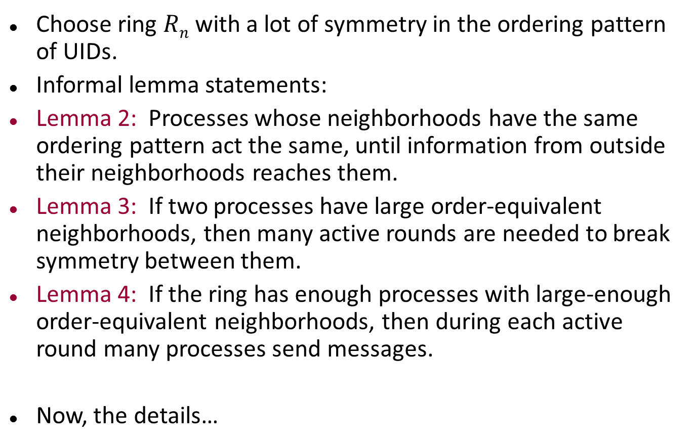
Proof overview, cont’d
Choose ring $Rn$with a lot of symmetry in the ordering pattern of UIDs.
Informal lemma statements:
Lemma 2: Processes whose neighborhoods have the same ordering pattern act the same, until information from outside their neighborhoods reaches them.
Lemma 3: If two processes have large order-equivalent neighborhoods, then many active rounds are needed to break symmetry between them.
Lemma 4: If the ring has enough processes with large-enough order-equivalent neighborhoods, then during each active round many processes send messages.
Now, the details…
Notes:
In an active round, at least one process i sends. So all that are symmetric with i (symmetry not yet broken) will send also.

Slide 11
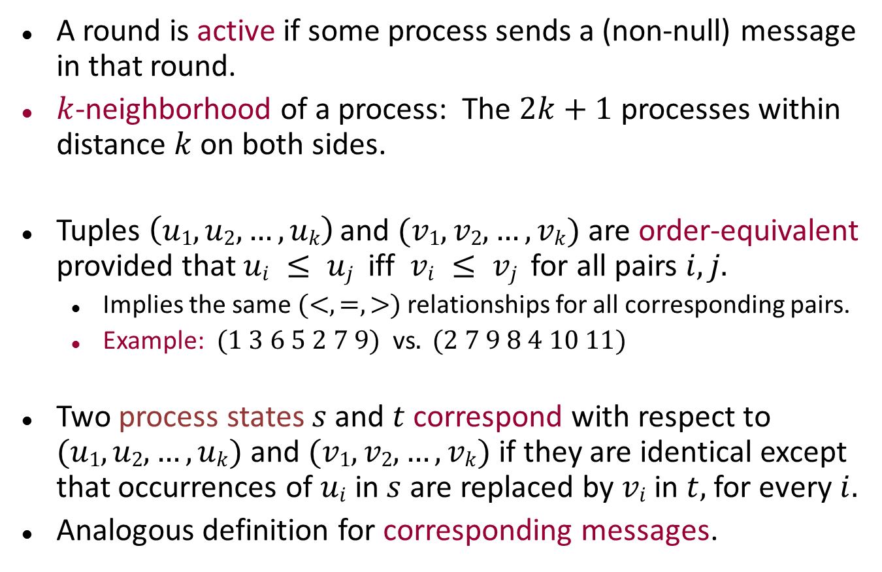
Definitions
A round is active if some process sends a (non-null) message in that round.
$k$-neighborhood of a process: The $2k+1$ processes within distance $k$on both sides.
Tuples $\left(u1, u2,…, uk\right)$and $(v1, v2,…, vk)$are order-equivalent provided that $ui ≤ uj$iff $vi ≤ vj$for all pairs $i, j.$
Implies the same $(<, =, >)$relationships for all corresponding pairs.
Example: $(1 3 6 5 2 7 9)$vs$. (2 7 9 8 4 10 11)$
Two process states $s$ and $t$ correspond with respect to $(u1, u2,…, uk)$ and $(v1, v2,…, vk)$if they are identical except that occurrences of $ui$ in $s$ are replaced by $vi$ in $t,$ for every $i.$
Analogous definition for corresponding messages.
Notes:
k-neighborhood is a sequence, read off clockwise around the ring.
More precisely, the “corresponding” definition also requires that all the UIDs in state s are chosen from the u’s, all the UIDs in state t are chosen from the v’s.

Slide 12
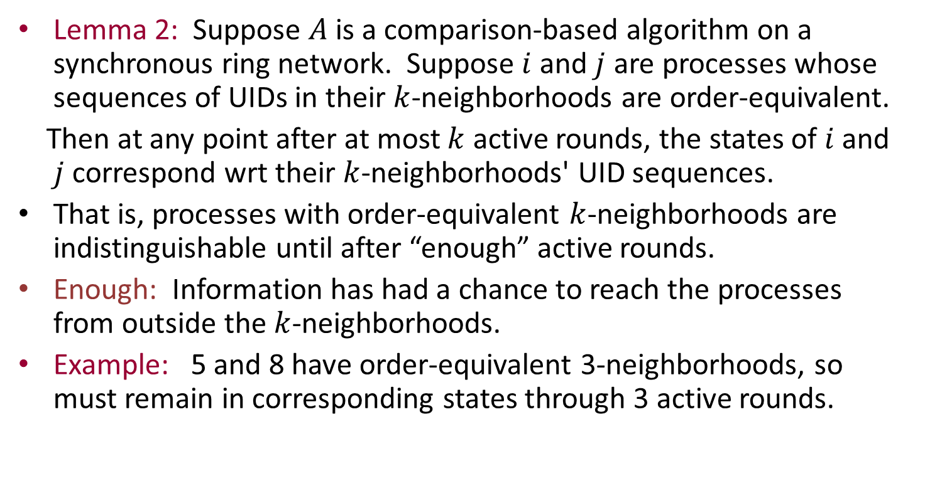
Key Lemma: Lemma 2
Lemma 2: Suppose $A$ is a comparison-based algorithm on a synchronous ring network. Suppose $i$ and $j$ are processes whose sequences of UIDs in their $k$-neighborhoods are order-equivalent.
Then at any point after at most $k$ active rounds, the states of $i$ and $j$correspond wrt their $k$-neighborhoods' UID sequences.
That is, processes with order-equivalent $k$-neighborhoods are indistinguishable until after “enough” active rounds.
Enough: Information has had a chance to reach the processes from outside the $k$-neighborhoods.
Example: 5 and 8 have order-equivalent 3-neighborhoods, so must remain in corresponding states through 3 active rounds.
2
7
9
8
5
4
6
10
3
11
1
Notes:
This doesn’t correspond exactly with the earlier paraphrase of Lemma 2, though it’s probably close enough. If we know that the states correspond, and the algorithm is comparison-based, then it follows that the processes will make the same decisions.

Slide 13
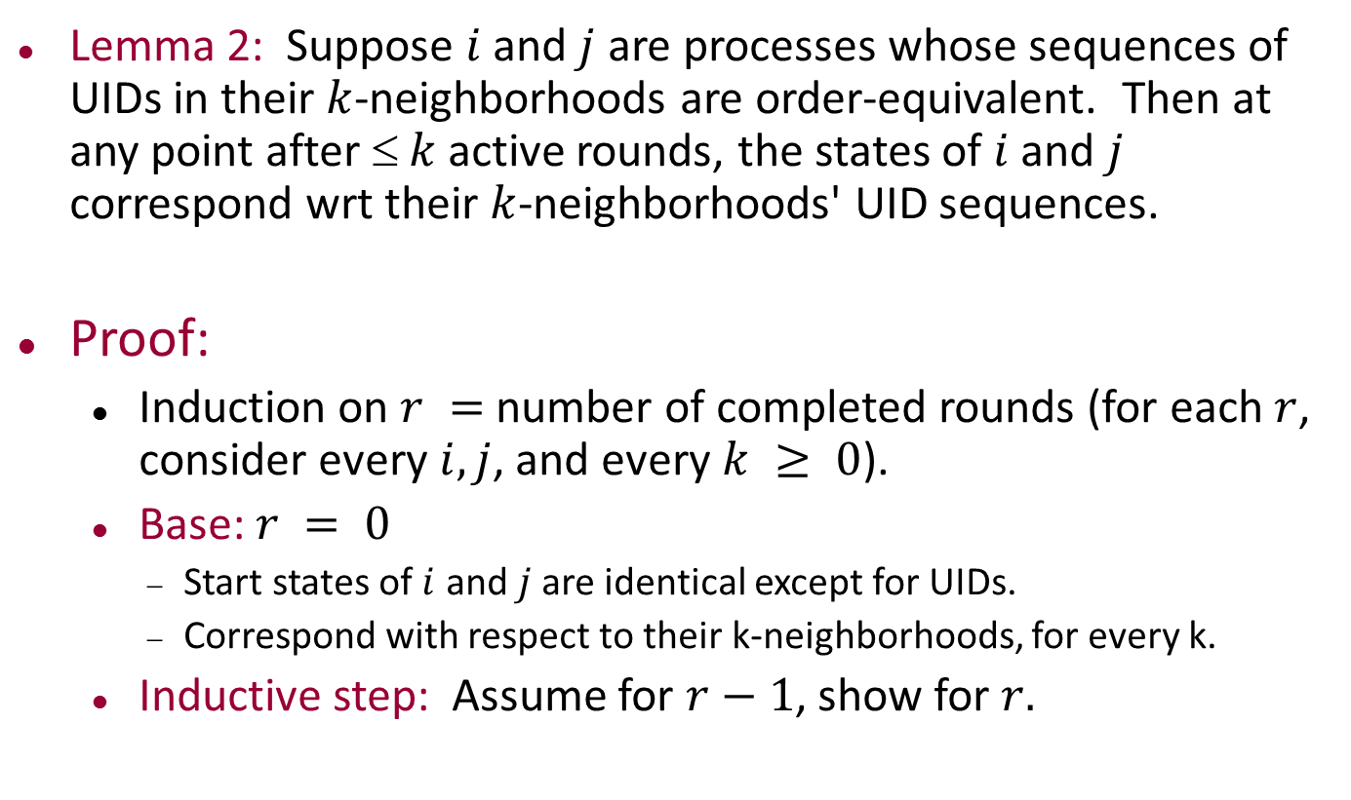
Proof of Lemma 2
Lemma 2: Suppose $i$and $j$ are processes whose sequences of UIDs in their $k$-neighborhoods are order-equivalent. Then at any point after $ k$ active rounds, the states of $i$ and $j$ correspond wrt their $k$-neighborhoods' UID sequences.
Proof:
Induction on $r =$ number of completed rounds (for each $r$, consider every $i, j$, and every $k ≥ 0$).
Base: $r = 0$
Start states of $i$ and $j$are identical except for UIDs.
Correspond with respect to their k-neighborhoods, for every k.
Inductive step: Assume for $r−1$, show for $r.$

Slide 14
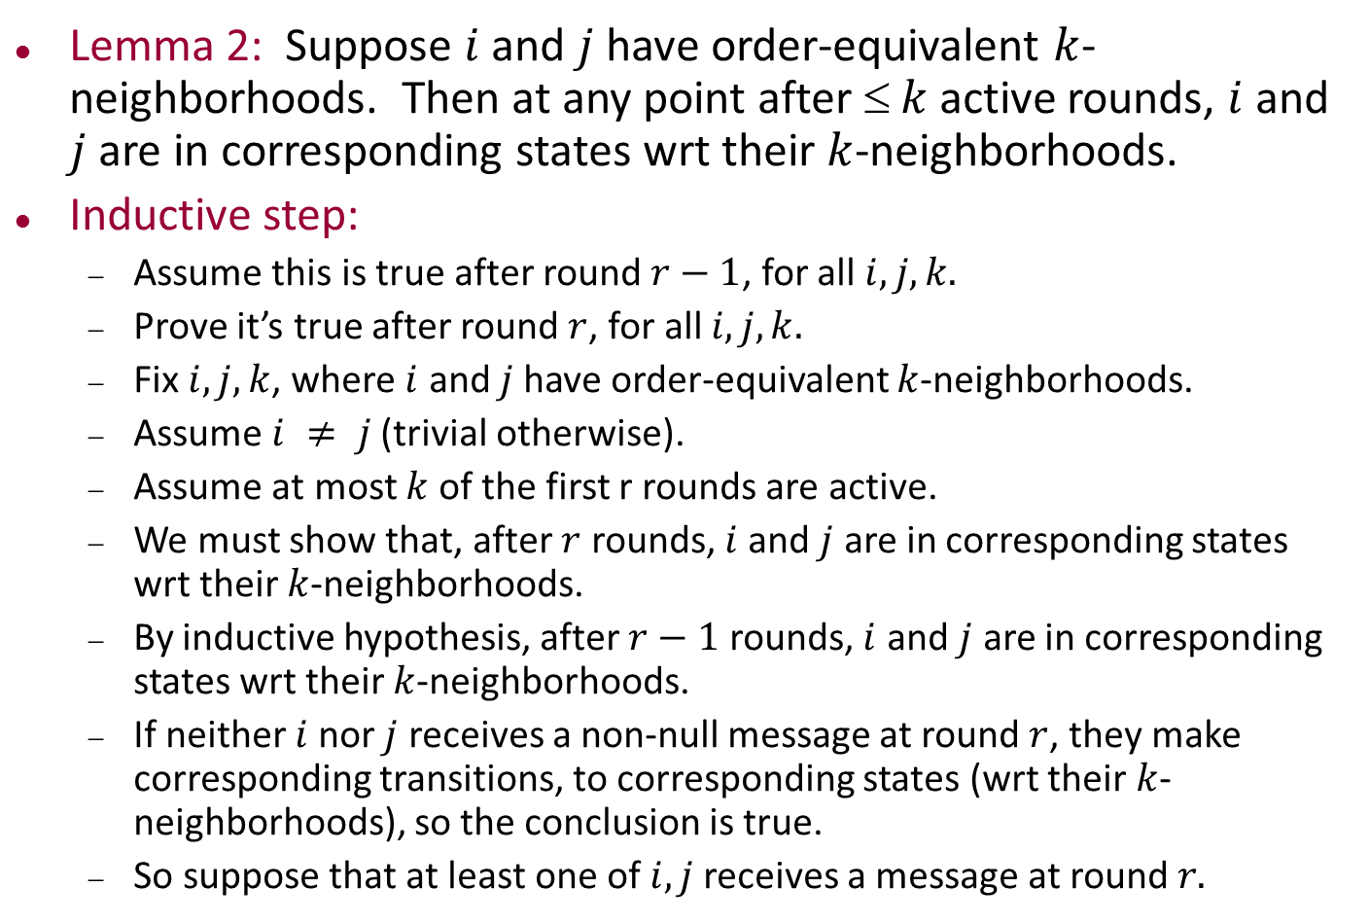
Proof of Lemma 2
Lemma 2: Suppose $i$ and $j$ have order-equivalent $k$-neighborhoods. Then at any point after $ k$ active rounds, $i$ and $j$are in corresponding states wrt their $k$-neighborhoods.
Inductive step:
Assume this is true after round $r−1$, for all $i, j, k.$
Prove it’s true after round $r$, for all $i, j, k.$
Fix $i, j, k$, where $i$ and $j$have order-equivalent $k$-neighborhoods.
Assume $i ≠ j$(trivial otherwise).
Assume at most $k$ of the first r rounds are active.
We must show that, after $r$ rounds, $i$and $j$ are in corresponding states wrt their $k$-neighborhoods.
By inductive hypothesis, after $r−1$ rounds, $i$ and $j$ are in corresponding states wrt their $k$-neighborhoods.
If neither $i$nor $j$ receives a non-null message at round $r$, they make corresponding transitions, to corresponding states (wrt their $k$-neighborhoods), so the conclusion is true.
So suppose that at least one of $i, j$receives a message at round $r.$

Slide 15
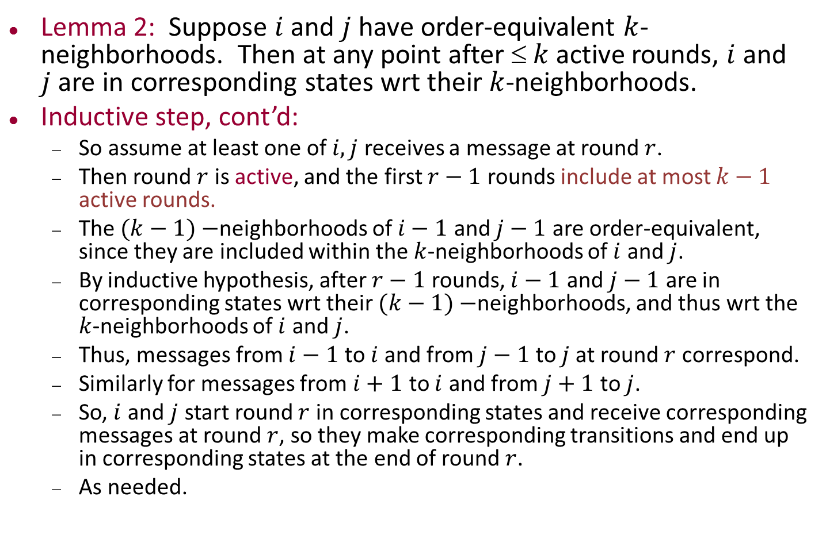
Proof of Lemma 2
Lemma 2: Suppose $i$ and $j$ have order-equivalent $k$-neighborhoods. Then at any point after $ k$ active rounds, $i$ and $j$are in corresponding states wrt their $k$-neighborhoods.
Inductive step, cont’d:
So assume at least one of $i,j$ receives a message at round $r$.
Then round $r$ is active, and the first $r−1$ rounds include at most $k−1$ active rounds.
The $(k−1)−$neighborhoods of $i−1$ and $j−1$ are order-equivalent, since they are included within the $k$-neighborhoods of $i$ and $j$.
By inductive hypothesis, after $r−1$ rounds, $i−1$ and $j−1$ are in corresponding states wrt their $(k−1)−$neighborhoods, and thus wrt the $k$-neighborhoods of $i$ and $j$.
Thus, messages from $i−1$ to $i$and from $j−1$ to $j$at round $r$ correspond.
Similarly for messages from $i+1$ to $i$ and from $j+1$ to $j$.
So, $i$ and $j$ start round $r$ in corresponding states and receive corresponding messages at round $r$, so they make corresponding transitions and end up in corresponding states at the end of round $r$.
As needed.
Notes:
The messages from i-1 to i and from j-1 to j correspond w.r.t. the k-neighborhoods of i and j.

Slide 16
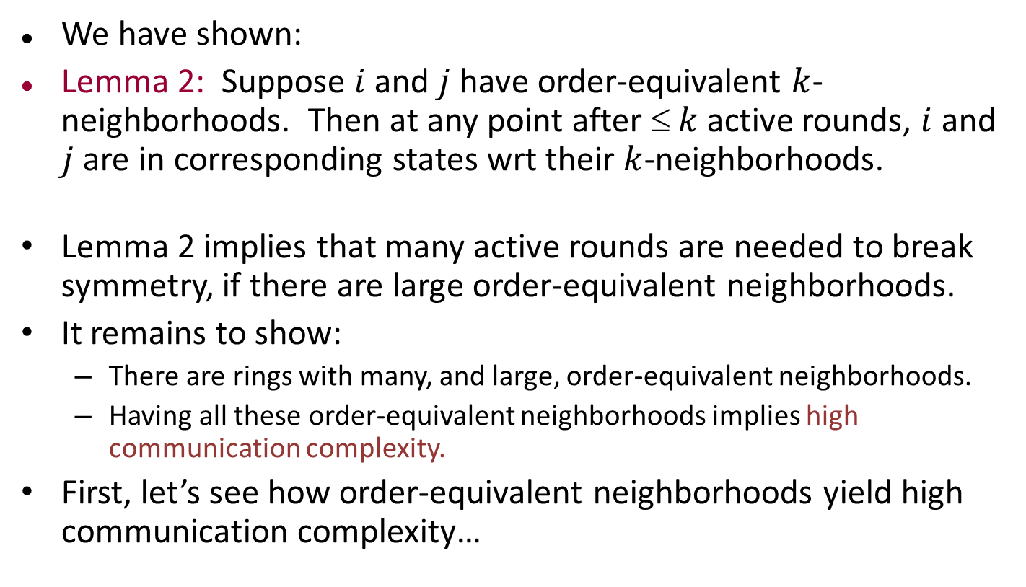
Proof of Theorem 1, cont’d
We have shown:
Lemma 2: Suppose $i$ and $j$ have order-equivalent $k$-neighborhoods. Then at any point after $ k$ active rounds, $i$ and $j$are in corresponding states wrt their $k$-neighborhoods.
Lemma 2 implies that many active rounds are needed to break symmetry, if there are large order-equivalent neighborhoods.
It remains to show:
There are rings with many, and large, order-equivalent neighborhoods.
Having all these order-equivalent neighborhoods implies high communication complexity.
First, let’s see how order-equivalent neighborhoods yield high communication complexity…
Notes:
We know already that having these neighborhoods implies lots of active rounds. Now we need to argue that that translates into high communication complexity.

Slide 17
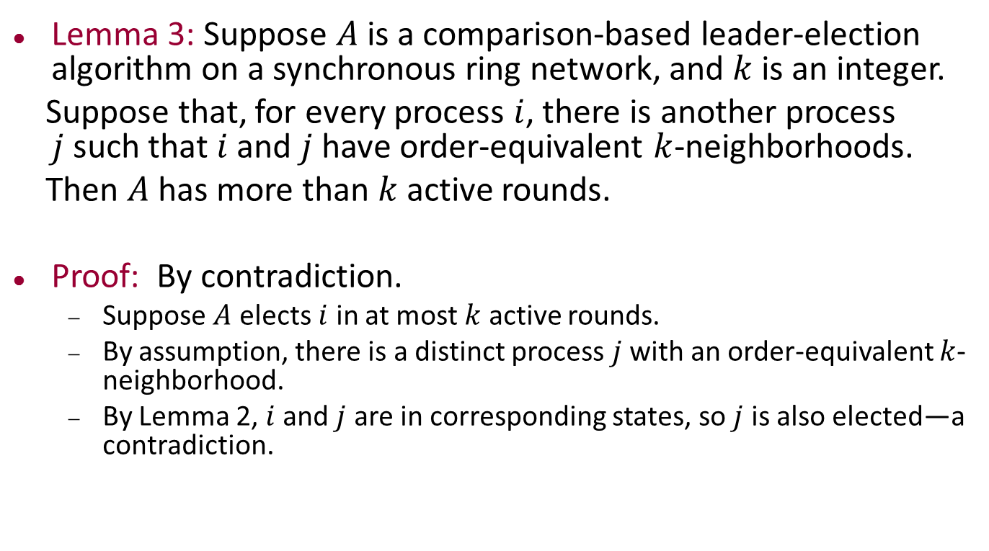
Lemma 3
Lemma 3: Suppose $A$ is a comparison-based leader-election algorithm on a synchronous ring network, and $k$ is an integer.
Suppose that, for every process $i$, there is another process $j$such that $i$ and $j$ have order-equivalent $k$-neighborhoods.
Then $A$ has more than $k$active rounds.
Proof: By contradiction.
Suppose $A$ elects $i$ in at most $k$ active rounds.
By assumption, there is a distinct process $j$ with an order-equivalent $k$-neighborhood.
By Lemma 2, $i$ and $j$ are in corresponding states, so $j$ is also elected—a contradiction.
Notes:
This isn’t stated exactly like the earlier paraphrase. That version talked about breaking symmetry between a particular pair of processes, whereas this goes further and talks about breaking symmetry between an elected leader and another process.

Slide 18
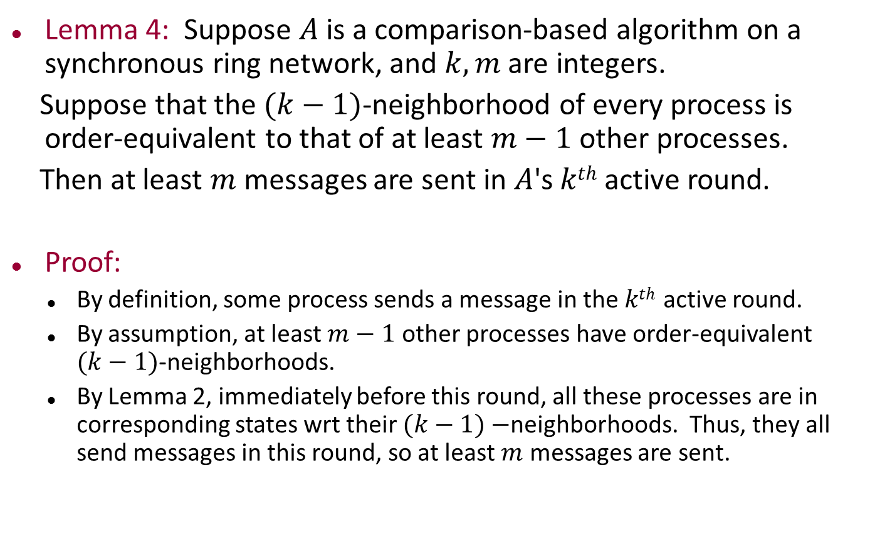
Lemma 4
Lemma 4: Suppose $A$ is a comparison-based algorithm on a synchronous ring network, and $k, m$ are integers.
Suppose that the $(k−1)$-neighborhood of every process is order-equivalent to that of at least $m−1$ other processes.
Then at least $m$ messages are sent in $A$'s $kth$ active round.
Proof:
By definition, some process sends a message in the $kth$active round.
By assumption, at least $m−1$ other processes have order-equivalent $(k−1)$-neighborhoods.
By Lemma 2, immediately before this round, all these processes are in corresponding states wrt their $(k−1)−$neighborhoods. Thus, they all send messages in this round, so at least $m$ messages are sent.
Notes:
Lemma 2 applies since before this round there are at most k-1 active rounds.

Slide 19
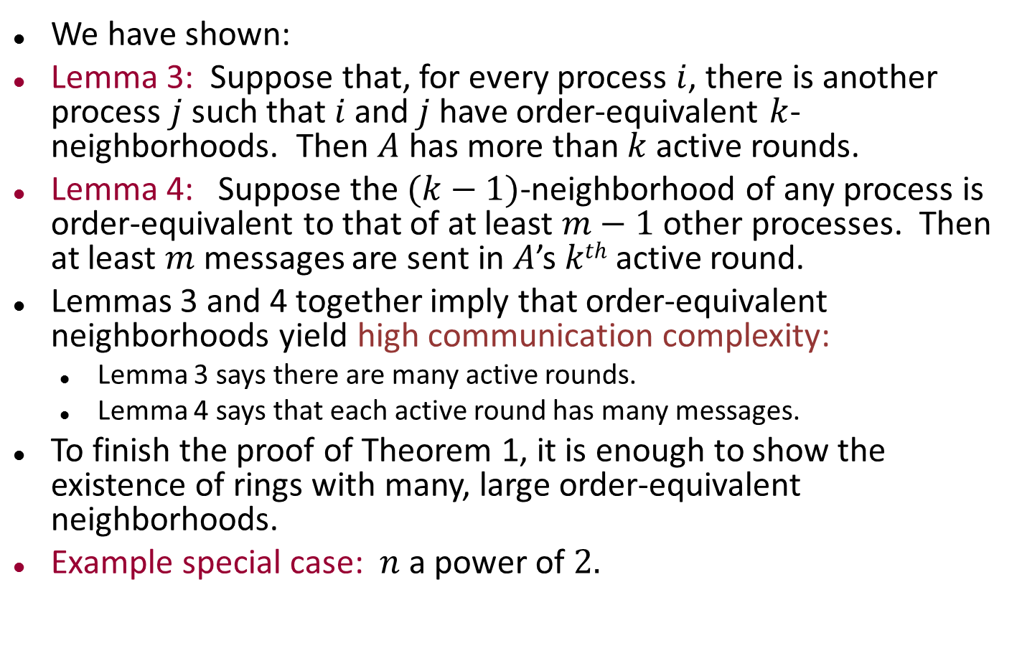
Proof of Theorem 1, cont’d
We have shown:
Lemma 3: Suppose that, for every process $i$, there is another process $j$ such that $i$ and $j$have order-equivalent $k$-neighborhoods. Then $A$ has more than $k$ active rounds.
Lemma 4: Suppose the $(k−1)$-neighborhood of any process is order-equivalent to that of at least $m−1$ other processes. Then at least $m$ messages are sent in $A$’s $kth$ active round.
Lemmas 3 and 4 together imply that order-equivalent neighborhoods yield high communication complexity:
Lemma 3 says there are many active rounds.
Lemma 4 says that each active round has many messages.
To finish the proof of Theorem 1, it is enough to show the existence of rings with many, large order-equivalent neighborhoods.
Example special case: $n$ a power of $2.$
Notes:
Lemma 3 says that, if we have enough order-equivalence, then we have many active rounds.
Lemma 4 says that, if we have a lot of order-equivalence, then we have many messages at each active round.
We’ll come back to a quantitative analysis after we fix some specific rings.

Slide 20


$n$ a power of $2$
Bit-reversal ring
UID is bit-reversed process number.
Example:
For every segment of length $n$/$2b$, there are (at least) $2b$ order-equivalent segments (including the given segment).
15
0
8
7
4
11
12
3
2
13
10
5
6
9
1
14
Notes:
Bit reversal: The ids are, going clockwise from the top: 0000, 1000, 0100, 1100, 0010, 1010, 0110, 1110, 0001, 1001, 0101, 1101, 0011, 1011, 0111, 1111.
If we reverse these strings, we are counting normally around the ring.

Slide 21
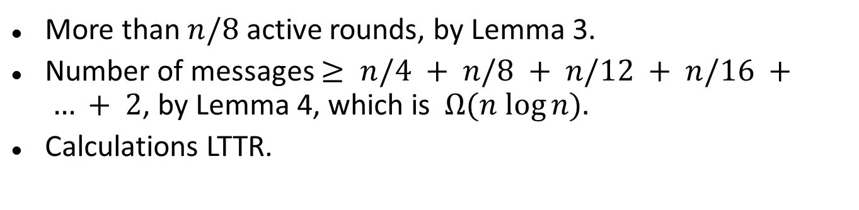
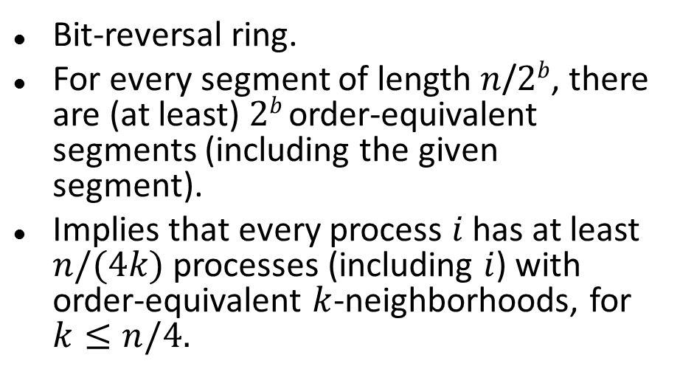
$n$ a power of $2$
15
0
8
Bit-reversal ring.
For every segment of length $n$/$2b$, there are (at least) $2b$ order-equivalent segments (including the given segment).
Implies that every process $i$ has at least $n/(4k)$ processes (including $i$) with order-equivalent $k$-neighborhoods, for $k≤n/4.$
7
4
11
12
3
2
13
10
5
6
9
1
14
More than $n/8$ active rounds, by Lemma 3.
Number of messages $≥ n/4 + n/8 + n/12 + n/16 + … + 2$, by Lemma 4, which is $Ω(n log⁡n).$
Calculations LTTR.
Notes:
To prove that there are > n/8 active rounds using Lemma 3, it suffices to know that, for every i, there is some other j with an n/8-neighborhood that is order-equivalent to that of i.
Why do we know this?
We know that every i has at least n/4k processes (including itself) with equivalent k-neighborhoods.
If we let k = n/8, this yields n/4k = 2, so i has at least one other j with equivalent n/8-nbhd.
Now we count the number of messages.
Add up the numbers for active rounds 1,…,n/8.
We have n/4(for 1) + n/8(for 2) + n/12(for 3) +…+ 2(for n/8).
This is a Harmonic Series sum.

Slide 22
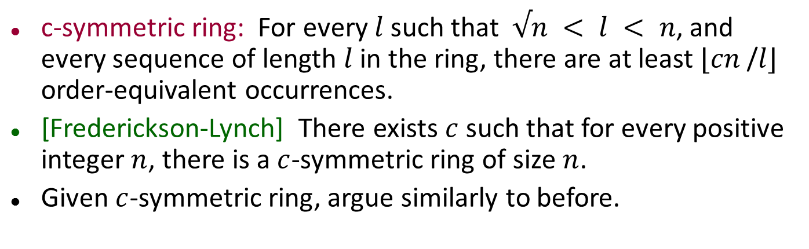
Proof idea for arbitrary n
c-symmetric ring: For every $l$such that$√n < l < n$, and every sequence of length $l$ in the ring, there are at least $⌊cn$/$l⌋$ order-equivalent occurrences.
[Frederickson-Lynch] There exists $c$ such that for every positive integer $n$, there is a $c$-symmetric ring of size $n$.
Given $c$-symmetric ring, argue similarly to before.
Notes:
Complicated construction using context-free grammar description.
The roundoffs affect the constants.

Slide 23
Basic Computation in General Synchronous Networks (not just rings)
Notes:
The rest of the class will study (simpler) algorithms, not lower bounds.

Slide 24
General synchronous networks
Not just rings, but arbitrary digraphs.
Today: Consider simple algorithms, for basic tasks like broadcasting messages, collecting responses, setting up communication structures.
These algorithms are simplified versions of algorithms that work in asynchronous networks. We will revisit them in a few weeks.
Soon: Maximal Independent Set, coloring.

Slide 25
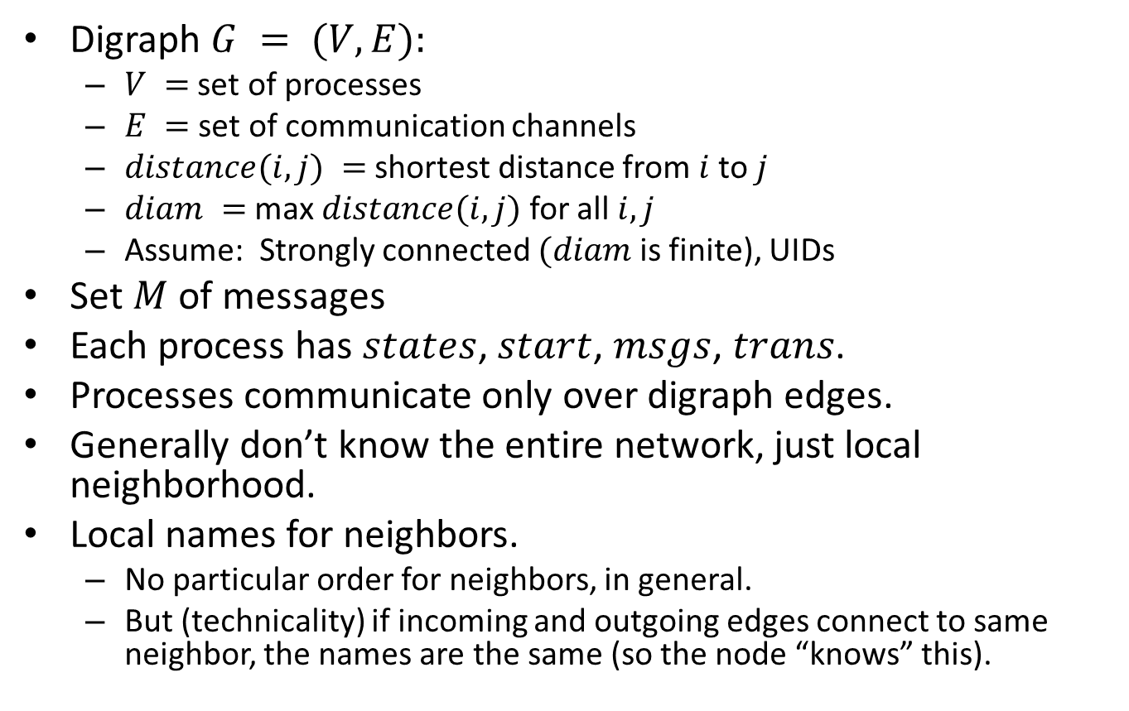
Assumptions
Digraph $G = (V,E):$
$V =$ set of processes
$E =$ set of communication channels
$distance(i,j) =$shortest distance from$i$ to $j$
$diam =$ max $distance(i,j)$ for all $i,j$
Assume: Strongly connected $(diam$is finite), UIDs
Set $M$ of messages
Each process has $states$, $start$, $msgs$, $trans$.
Processes communicate only over digraph edges.
Generally don’t know the entire network, just local neighborhood.
Local names for neighbors.
No particular order for neighbors, in general.
But (technicality) if incoming and outgoing edges connect to same neighbor, the names are the same (so the node “knows” this).
Notes:
The first part of this slides is review from class 1.
The local names are called “port names” in the 6.046 distributed algorithms slides.

Slide 26
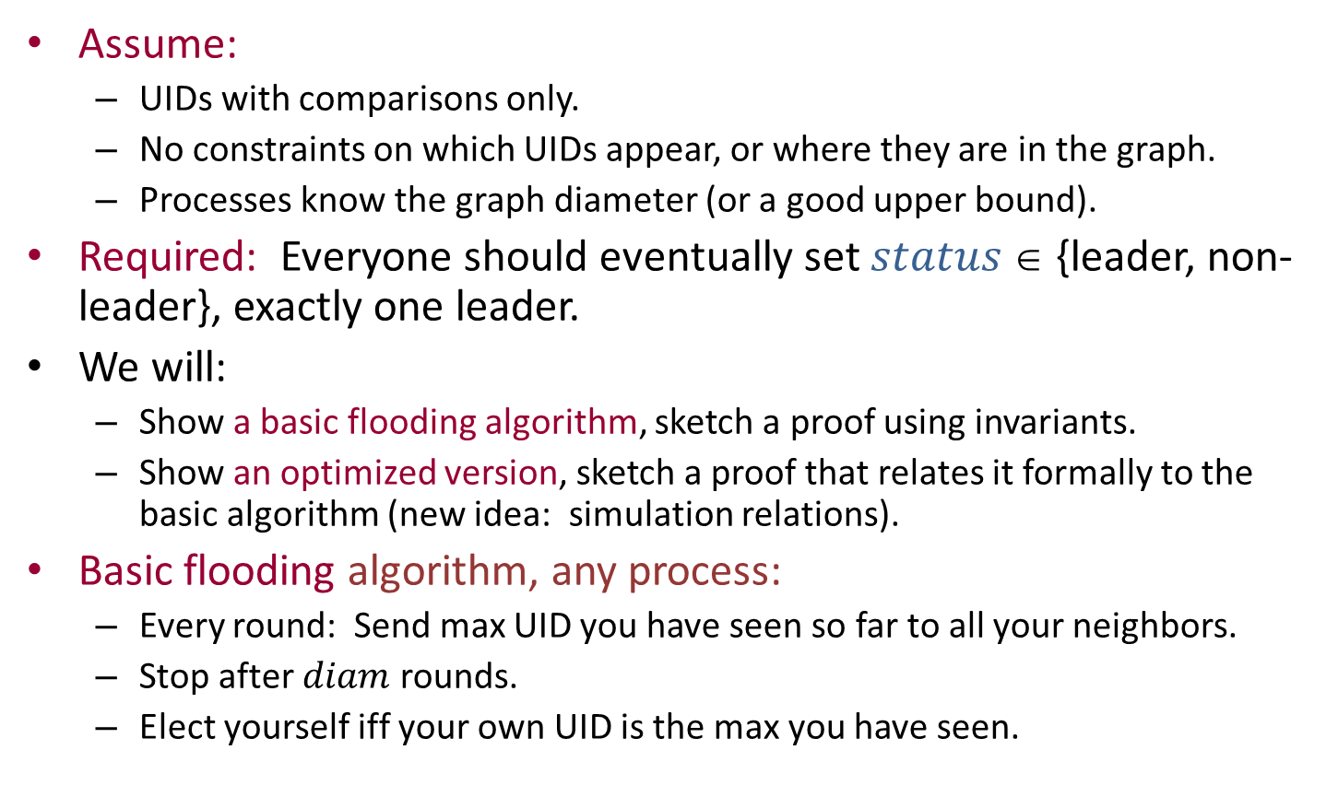
Leader election in general synchronous networks
Assume:
UIDs with comparisons only.
No constraints on which UIDs appear, or where they are in the graph.
Processes know the graph diameter (or a good upper bound).
Required: Everyone should eventually set $status$ ∈ {leader, non-leader}, exactly one leader.
We will:
Show a basic flooding algorithm, sketch a proof using invariants.
Show an optimized version, sketch a proof that relates it formally to the basic algorithm (new idea: simulation relations).
Basic flooding algorithm, any process:
Every round: Send max UID you have seen so far to all your neighbors.
Stop after $diam$ rounds.
Elect yourself iff your own UID is the max you have seen.
Notes:
“Good upper bound” generally means within a constant factor of the correct count.

Slide 27
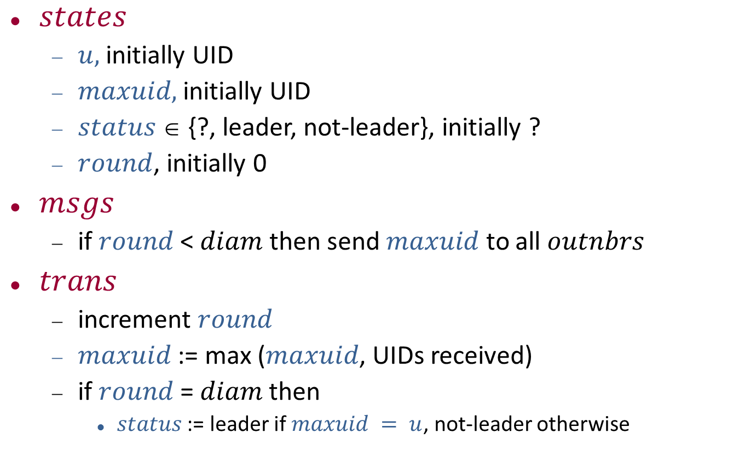
Basic flooding algorithm
$states$
$u,$ initially UID
$maxuid,$initially UID
$status$ ∈ {?, leader, not-leader}, initially ?
$round$, initially 0
$msgs$
if $round$ < $diam$ then send $maxuid$ to all $outnbrs$
$trans$
increment $round$
$maxuid$ := max ($maxuid$, UIDs received)
if $round$= $diam$ then
$status$ := leader if $maxuid = u$, not-leader otherwise

Slide 28
Basic flooding algorithm
2
2
1
1
5
4
5
3
4
3
6
Start configuration
6
Notes:
The blue values are the maxuids.

Slide 29
Basic flooding algorithm
2
2
2
1
2
1
1
2
5
5
1
3
4
5
4
4
3
3
6
5
6
6
Round 1 (msgs)
6
Notes:
The messages everyone sends.

Slide 30
Basic flooding algorithm
5
2
2
1
2
3
1
2
5
5
1
3
4
5
6
4
3
6
6
5
6
6
Round 1 (trans)
6

Slide 31
Basic flooding algorithm
5
2
1
3
5
4
5
3
6
6
6
Round 2 (start)
6

Slide 32
Basic flooding algorithm
5
5
2
1
5
3
3
5
5
5
3
6
4
5
6
6
3
6
6
5
6
6
Round 2 (msgs)
6

Slide 33
Basic flooding algorithm
5
5
2
1
5
6
3
5
5
5
3
6
4
6
6
6
3
6
6
5
6
6
Round 2 (trans)
6

Slide 34
Basic flooding algorithm
5
2
1
6
5
4
6
3
6
6
6
Round 3 (start)
6

Slide 35
Basic flooding algorithm
5
5
2
1
5
6
6
5
6
5
6
6
4
6
6
6
3
6
6
6
6
6
Round 3 (msgs)
6

Slide 36
Basic flooding algorithm
6
5
2
1
5
6
6
5
6
5
6
6
4
6
6
6
3
6
6
6
6
6
Round 3 (trans)
6

Slide 37
Basic flooding algorithm
6
2
1
6
5
4
6
3
6
6
6
Round 4 (start)
6

Slide 38
Basic flooding algorithm
6
6
2
1
6
6
6
6
6
5
6
6
4
6
6
6
3
6
6
6
6
6
Round 4 (msgs)
6

Slide 39
Basic flooding algorithm
6
2
1
6
5
4
6
3
6
6
6
Round 4 (trans)
6
Notes:
Diameter = 4, so stop after 4 rounds.
E.g., distance from 3 to 2 is 4 (via 1 to 4 to 5)
The circled node, 6, is the leader.

Slide 40
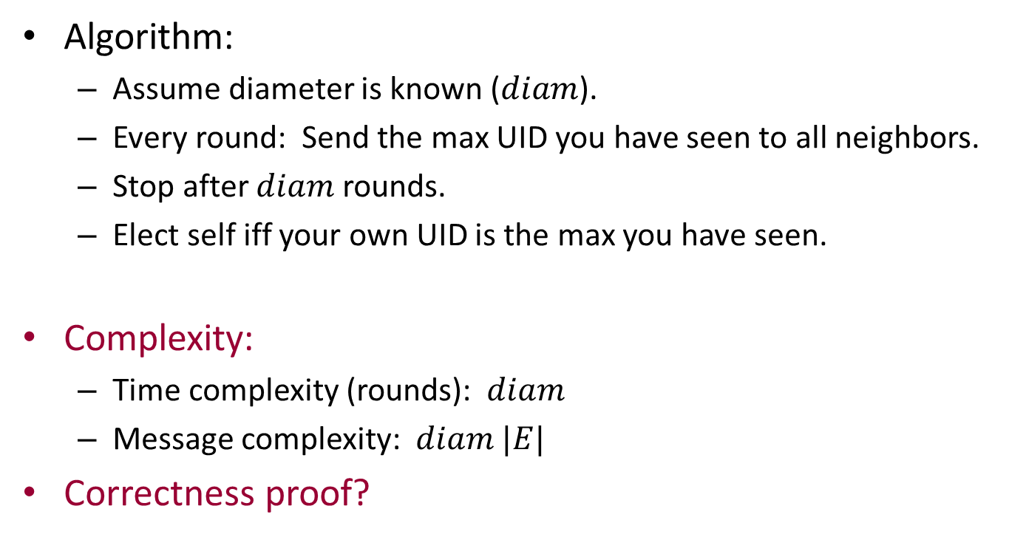
Basic flooding algorithm
Algorithm:
Assume diameter is known ($diam$).
Every round: Send the max UID you have seen to all neighbors.
Stop after $diam$ rounds.
Elect self iff your own UID is the max you have seen.
Complexity:
Time complexity (rounds): $diam$
Message complexity: $diam |E|$
Correctness proof?

Slide 41
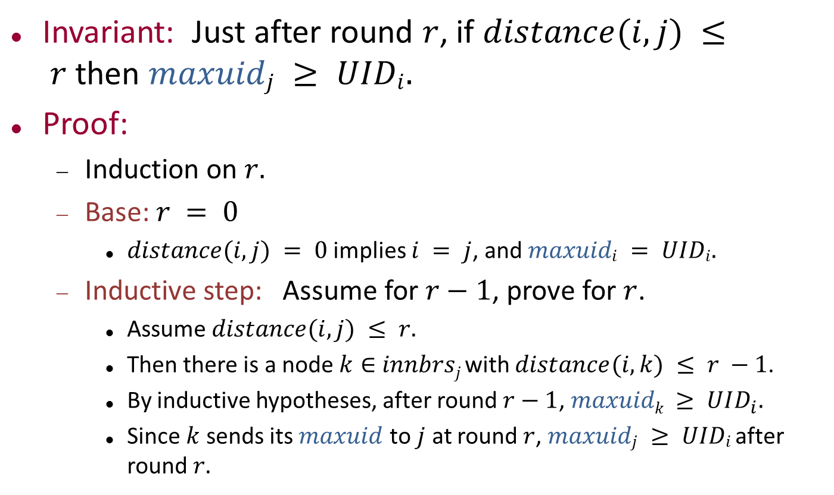
Key invariant
Invariant: Just after round $r$, if $distance(i,j) ≤ r$then $maxuidj ≥ UIDi.$
Proof:
Induction on $r.$
Base: $r = 0$
$distance(i,j) = 0$implies $i = j$, and $maxuidi = UIDi.$
Inductive step: Assume for $r−1$, prove for $r$.
Assume $distance(i,j) ≤ r.$
Then there is a node $k∈$ $innbrsj$with $distance(i,k) ≤ r −1$.
By inductive hypotheses, after round $r−1$, $maxuidk ≥ UID_{i}.$
Since $k$ sends its $maxuid$ to $j$ at round $r$, $maxuidj ≥ UIDi$after round $r.$
Notes:
The idea is really obvious: Messages propagate to the indicated distance.

Slide 42
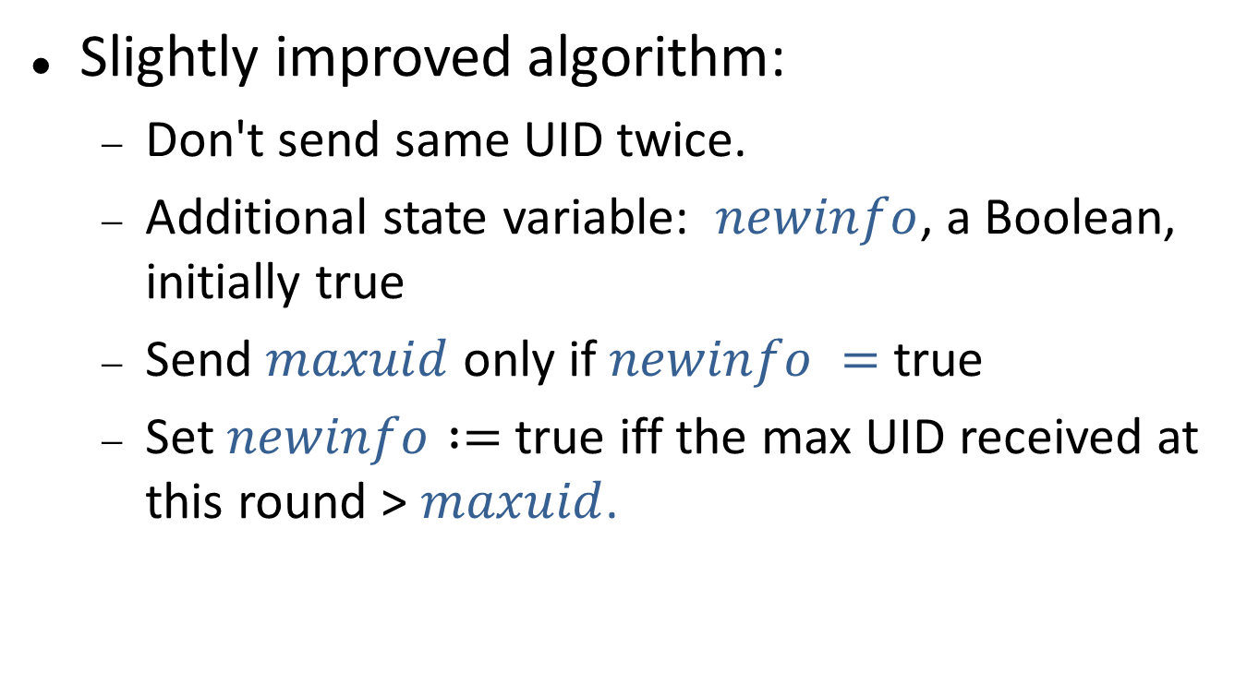
Reducing the message complexity
Slightly improved algorithm:
Don't send same UID twice.
Additional state variable: $newinfo$, a Boolean, initially true
Send $maxuid$ only if $newinfo =$ true
Set $newinfo :=$true iff the max UID received at this round > $maxuid$.

Slide 43
Improved algorithm
2
2
1
1
5
4
5
3
4
3
6
Start configuration
6
Notes:
Rerun the previous animation with the extra messages pruned out.

Slide 44
Improved algorithm
2
2
2
1
2
1
1
2
5
5
1
3
4
5
4
4
3
3
6
5
6
6
Round 1 (msgs)
6

Slide 45
Improved algorithm
5
2
2
1
2
3
1
2
5
5
1
3
4
5
6
4
3
6
6
5
6
6
Round 1 (trans)
6
Notes:
The red numbers indicate max-uids at nodes that have already sent out the same uid.
So these don’t represent new info, and needn’t be sent again.
The blue numbers represent new info.

Slide 46
Improved algorithm
5
2
1
3
5
4
5
3
6
6
6
Round 2 (start)
6

Slide 47
Improved algorithm
5
5
2
1
5
3
3
5
5
3
6
4
5
6
6
3
6
6
Round 2 (msgs)
6
Notes:
Now only 1,2,3, and 4 send out their max-uid values.

Slide 48
Improved algorithm
5
5
2
1
5
6
3
5
5
3
6
4
6
6
6
3
6
6
Round 2 (trans)
6

Slide 49
Improved algorithm
5
2
1
6
5
4
6
3
6
6
6
Round 3 (start)
6

Slide 50
Improved algorithm
5
2
1
6
6
6
5
6
4
6
3
6
6
6
6
Round 3 (msgs)
6
Notes:
Now only 1 and 5 send.

Slide 51
Improved algorithm
6
2
1
6
6
6
5
6
4
6
3
6
6
6
6
Round 3 (trans)
6
Notes:
Only 2 receives new information at round 3.

Slide 52
Improved algorithm
6
2
1
6
5
4
6
3
6
6
6
Round 4 (start)
6

Slide 53
Improved algorithm
6
6
2
1
6
6
6
5
4
6
3
6
6
6
Round 4 (msgs)
6

Slide 54
Improved algorithm
6
2
1
6
5
4
6
3
6
6
6
Round 4 (trans)
6

Slide 55
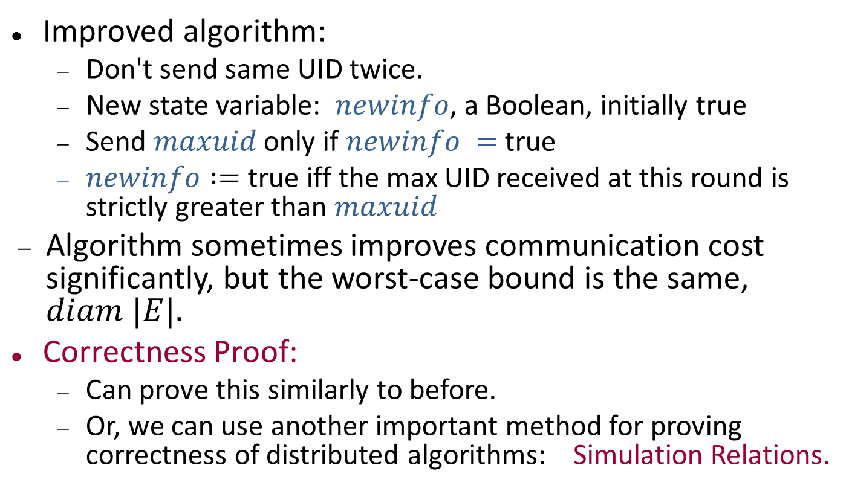
Improved algorithm
Improved algorithm:
Don't send same UID twice.
New state variable: $newinfo$, a Boolean, initially true
Send $maxuid$ only if $newinfo =$ true
$newinfo :=$true iff the max UID received at this round is strictly greater than $maxuid$
Algorithm sometimes improves communication cost significantly, but the worst-case bound is the same, $diam |E|.$
Correctness Proof:
Can prove this similarly to before.
Or, we can use another important method for proving correctness of distributed algorithms: Simulation Relations.

Slide 56
Simulation relation
Relates a new algorithm formally to an original one that has already been proved correct.
Correctness then carries over from the old algorithm to the new algorithm.
Often used to show correctness of optimized algorithms.
Can repeat this in several stages, adding more optimizations.
“Run the two algorithms side by side and relate them.”
Define a simulation relation between states of the two algorithms:
Satisfied by start states.
Preserved by every transition.
Outputs should be the same from related states.
Notes:
It’s like an invariant of the combination of the two algorithms.

Slide 57
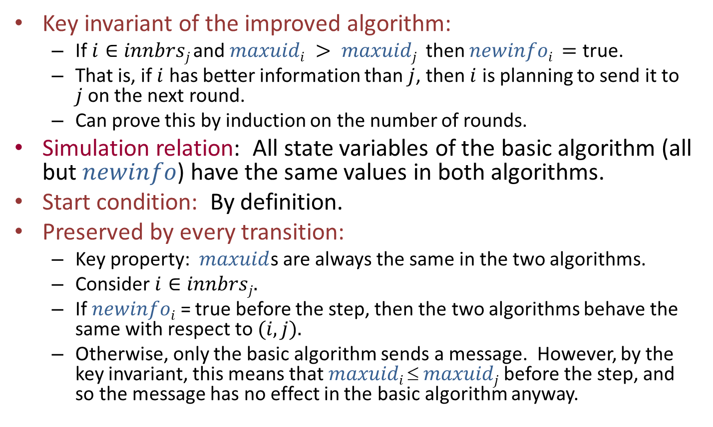
Simulation relation between the improved and basic algorithms
Key invariant of the improved algorithm:
If $i∈innbrsj$and $maxuidi > maxuidj$ then $newinfoi =$ true.
That is, if $i$ has better information than $j$, then $i$ is planning to send it to $j$on the next round.
Can prove this by induction on the number of rounds.
Simulation relation: All state variables of the basic algorithm (all but $newinfo$) have the same values in both algorithms.
Start condition: By definition.
Preserved by every transition:
Key property: $maxuid$s are always the same in the two algorithms.
Consider $i∈innbrsj.$
If $newinfoi$ = true before the step, then the two algorithms behave the same with respect to $(i,j).$
Otherwise, only the basic algorithm sends a message. However, by the key invariant, this means that $maxuidi  maxuidj$before the step, and so the message has no effect in the basic algorithm anyway.
Notes:
Before proving a simulation relation, it’s often helpful to state and prove some basic invariants about the new optimized algorithm.
We’re leaving out the proof of the key invariant here. It’s straightforward, but a bit detailed and tedious. It’s in the book.

Slide 58
Why all these proofs?
Distributed algorithms can be very subtle and complicated.
Easy to make mistakes.
Careful reasoning about algorithm steps is generally needed.
It’s more necessary here than for sequential algorithms.
Moreover, we prefer proofs that are systematic, like invariant and simulation relation proofs.
Structure makes it easier to design (and read) new proofs.
Makes it possible to keep track of numerous details.
Proofs lend themselves to machine assistance, using theorem-provers, model-checkers, etc.
Notes:
Adam Chlipala’s group does formal machine proofs of distributed algorithms, and many other things.
A good project for this course might be to use theorem-provers to prove some distributed algorithms (if you already know how to use a theorem-prover).

Slide 59
Now, other problems besides leader election…
This week:
Breadth-First Search (BFS), B-F spanning trees
Shortest-paths spanning treed
Minimum Spanning Trees (MSTs)
Maximal Independent Sets (MISs)
Next week (Stephan Holzer):
MIS, revisited
Graph coloring
MST, revisited

Slide 60
Breadth-First Search

Slide 61
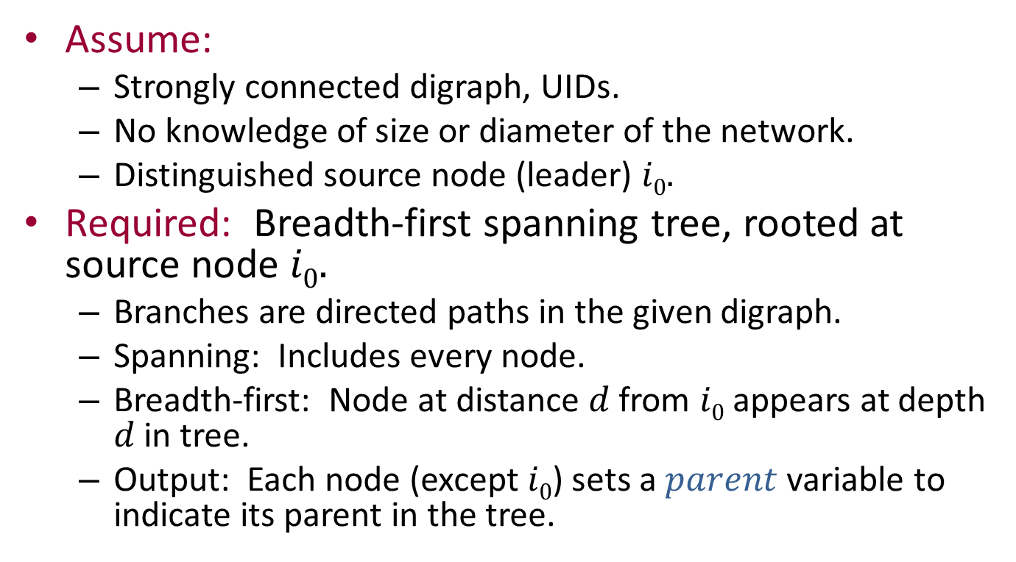
Breadth-first search
Assume:
Strongly connected digraph, UIDs.
No knowledge of size or diameter of the network.
Distinguished source node (leader) $i0.$
Required: Breadth-first spanning tree, rooted at source node $i0.$
Branches are directed paths in the given digraph.
Spanning: Includes every node.
Breadth-first: Node at distance $d$ from $i0$ appears at depth $d$ in tree.
Output: Each node (except $i0$) sets a $parent$ variable to indicate its parent in the tree.
Notes:
So tree representation is distributed.

Slide 62
Breadth-first search
2
1
5
4
3
6

Slide 63
Breadth-first search
2
1
5
4
3
6
Notes:
This is a BF spanning tree. In this case, it happens to be unique. The arrows are pointed from parent to child instead of child to parent as one might think.

Slide 64
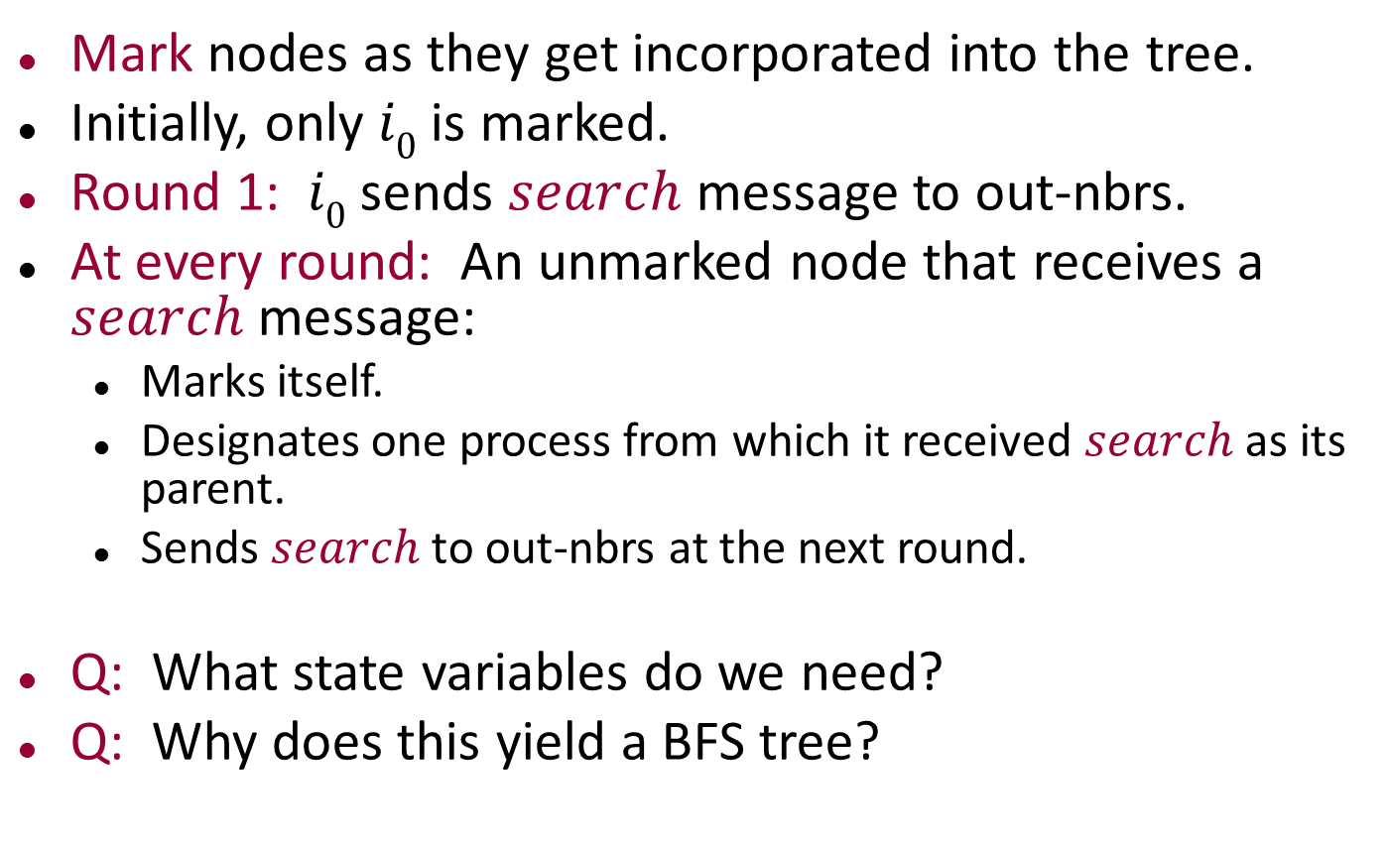
Breadth-first search algorithm
Mark nodes as they get incorporated into the tree.
Initially, only $i0$ is marked.
Round 1: $i0$ sends $search$ message to out-nbrs.
At every round: An unmarked node that receives a $search$message:
Marks itself.
Designates one process from which it received $search$ as its parent.
Sends $search$ to out-nbrs at the next round.
Q: What state variables do we need?
Q: Why does this yield a BFS tree?
Notes:
State variables: mark flag, parent pointer, new-info flag (indicates when parent has just been set up, before sending the search message).
Yields a BFS tree because the branches are all created synchronously.

Slide 65
Breadth-first search
2
1
5
4
3
6
Round 1 (start)

Slide 66
Breadth-first search
2
1
5
4
s
3
6
Round 1 (msgs)

Slide 67
Breadth-first search
2
1
5
4
s
3
6
Round 1 (trans)

Slide 68
Breadth-first search
2
1
5
4
3
6
Round 2 (start)

Slide 69
Breadth-first search
2
1
s
5
4
3
s
6
Round 2 (msgs)

Slide 70
Breadth-first search
2
1
s
5
4
3
s
6
Round 2 (trans)

Slide 71
Breadth-first search
2
1
5
4
3
6
Round 3 (start)

Slide 72
Breadth-first search
2
1
s
s
s
5
4
3
s
s
6
Round 3 (msgs)

Slide 73
Breadth-first search
2
1
s
s
s
5
4
3
s
s
6
Round 3 (trans)

Slide 74
Breadth-first search
2
1
5
4
3
6
Round 4 (start)

Slide 75
Breadth-first search
2
1
s
5
s
s
4
3
6
Round 4 (msgs)

Slide 76
Breadth-first search
2
1
s
5
s
s
4
3
6
Round 4 (trans)

Slide 77
Breadth-first search
2
1
5
4
3
6
Round 5 (start)

Slide 78
Breadth-first search
2
1
5
4
3
6
Round 5 (msgs)
Notes:
No messages get sent now, because everyone has already sent its messages.

Slide 79
Breadth-first search
2
1
5
4
3
6
Round 5 (trans)

Slide 80
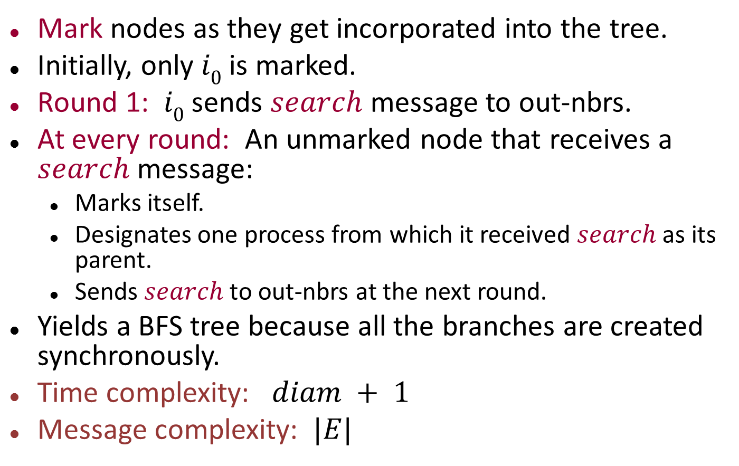
Breadth-first search algorithm
Mark nodes as they get incorporated into the tree.
Initially, only $i0$ is marked.
Round 1: $i0$ sends $search$ message to out-nbrs.
At every round: An unmarked node that receives a $search$message:
Marks itself.
Designates one process from which it received $search$ as its parent.
Sends $search$ to out-nbrs at the next round.
Yields a BFS tree because all the branches are created synchronously.
Time complexity: $diam + 1$
Message complexity: $|E|$
Notes:
State variables: mark flag, parent pointer, new-info flag (indicates when parent has just been set up, before sending the search message).
Yields a BFS tree because the branches are all created synchronously.
Not giving any proofs here. Could prove this using invariants again.
|E| here is number of DIRECTED edges. Not sure if this is always handled consistently in the slides/book.

Slide 81
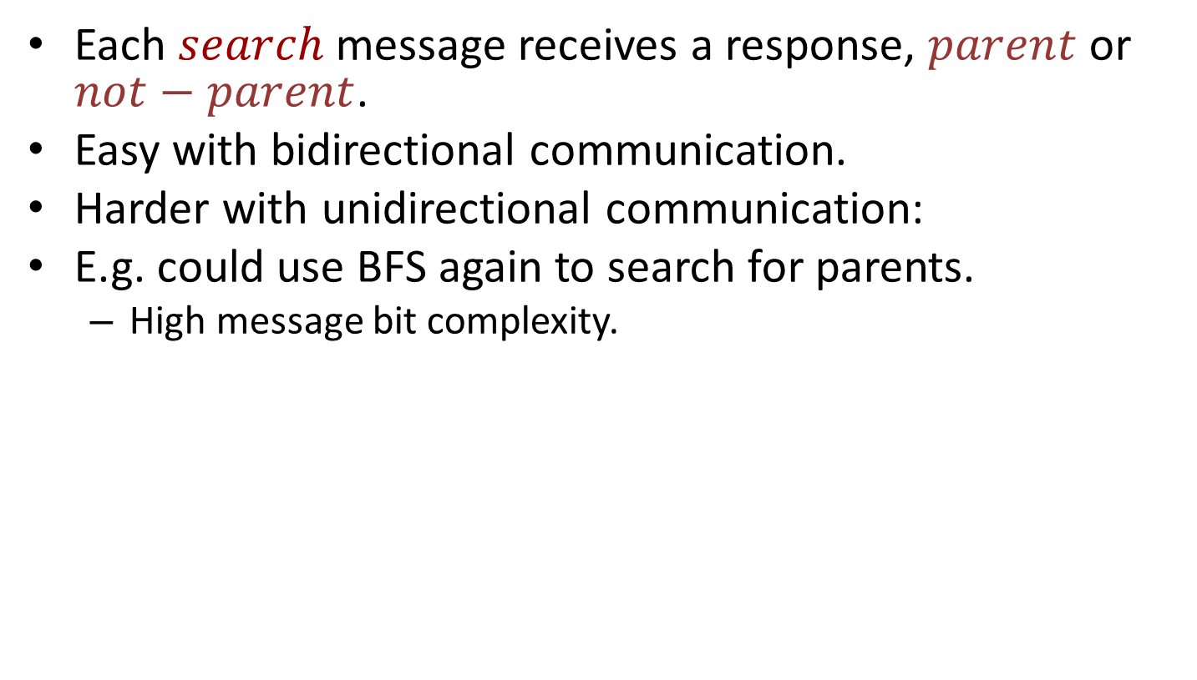
Adding child pointers to BFS
Each $search$message receives a response, $parent$ or $not−parent$.
Easy with bidirectional communication.
Harder with unidirectional communication:
E.g. could use BFS again to search for parents.
High message bit complexity.
Notes:
Once the parent receives the response, it can set pointers to its children.

Slide 82
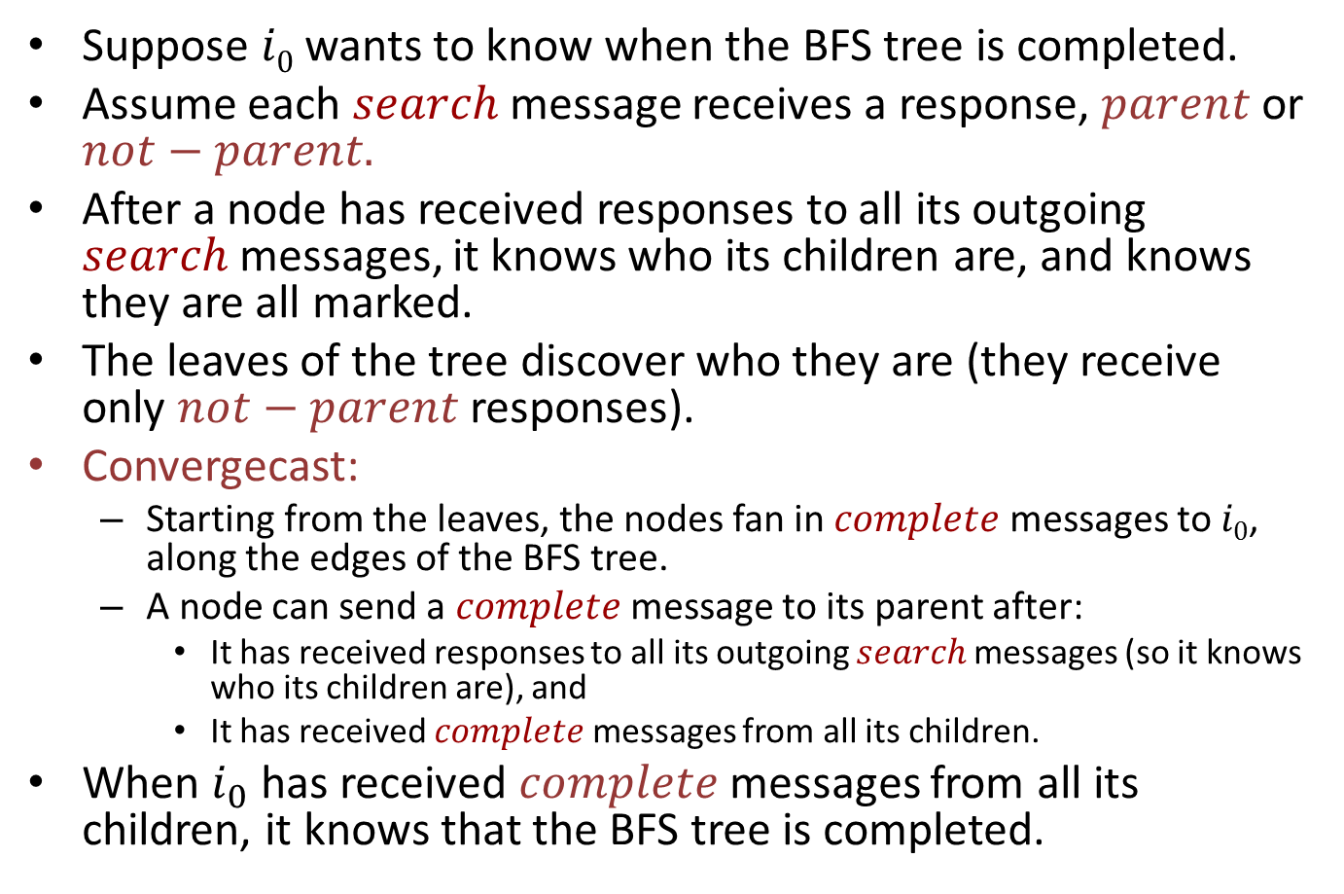
Termination for BFS
Suppose $i0$ wants to know when the BFS tree is completed.
Assume each $search$ message receives a response, $parent$or $not−parent.$
After a node has received responses to all its outgoing $search$messages, it knows who its children are, and knows they are all marked.
The leaves of the tree discover who they are (they receive only $not−parent$ responses).
Convergecast:
Starting from the leaves, the nodes fan in $complete$ messages to $i0$, along the edges of the BFS tree.
A node can send a $complete$message to its parent after:
It has received responses to all its outgoing $search$messages (so it knows who its children are), and
It has received $complete$ messages from all its children.
When $i_{0}$ has received $complete$ messages from all its children, it knows that the BFS tree is completed.

Slide 83
Convergecast
Complete!
complete
complete
complete
complete
complete
complete
complete
Notes:
This is a depiction of a more general type of convergecast than what arises in this algorithm---it allows asynchrony in when the various complete messages are send and arrive. The idea works even without any synchronization.

Slide 84
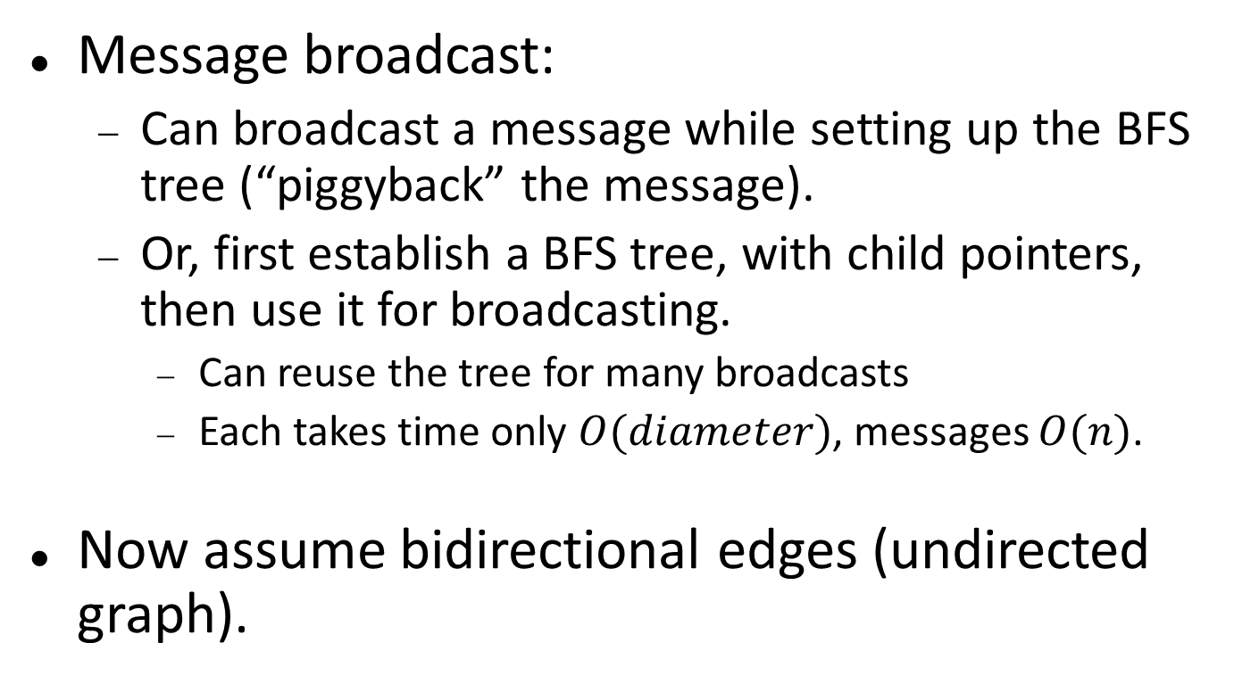
Applications of BFS
Message broadcast:
Can broadcast a message while setting up the BFS tree (“piggyback” the message).
Or, first establish a BFS tree, with child pointers, then use it for broadcasting.
Can reuse the tree for many broadcasts
Each takes time only $O(diameter)$, messages $O(n)$.
Now assume bidirectional edges (undirected graph).

Slide 85
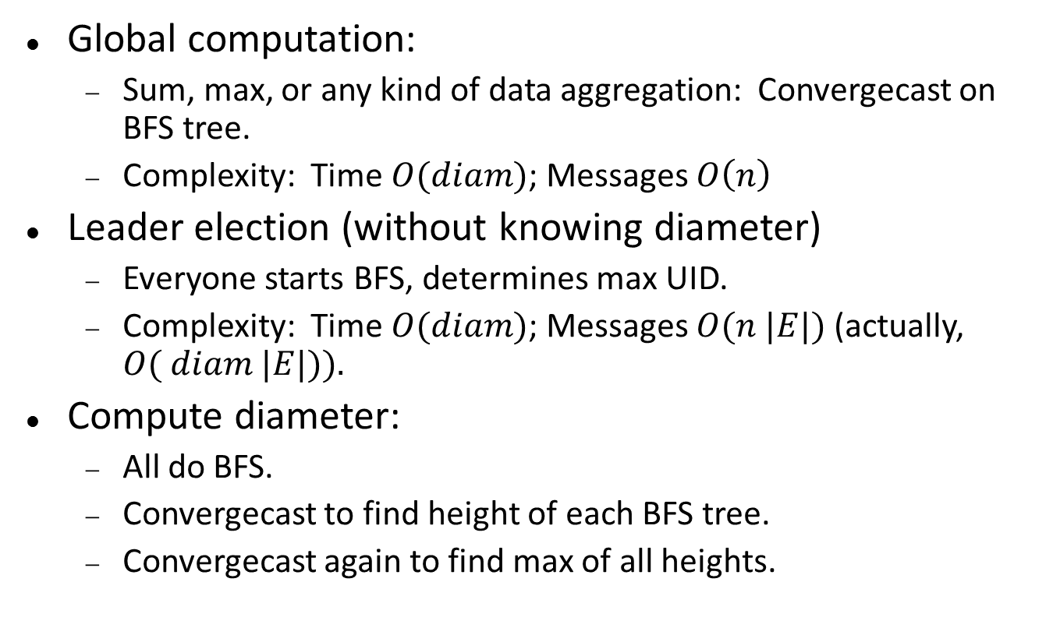
Applications of BFS
Global computation:
Sum, max, or any kind of data aggregation: Convergecast on BFS tree.
Complexity: Time $O(diam)$; Messages $O\left(n\right)$
Leader election (without knowing diameter)
Everyone starts BFS, determines max UID.
Complexity: Time $O(diam)$; Messages $O(n |E|)$(actually, $O( diam |E|)).$
Compute diameter:
All do BFS.
Convergecast to find height of each BFS tree.
Convergecast again to find max of all heights.
Notes:
For global computation, we assume a known source i_0.
For leader election and computing diameter, no distinguished node.
The O(n E) bound is from n executions of the BFS algorithm.
The O(diam E) bound recognizes that each edge could carry only one message per round---can piggyback those of different algorithms and count them as one.

Slide 86
Shortest Paths

Slide 87
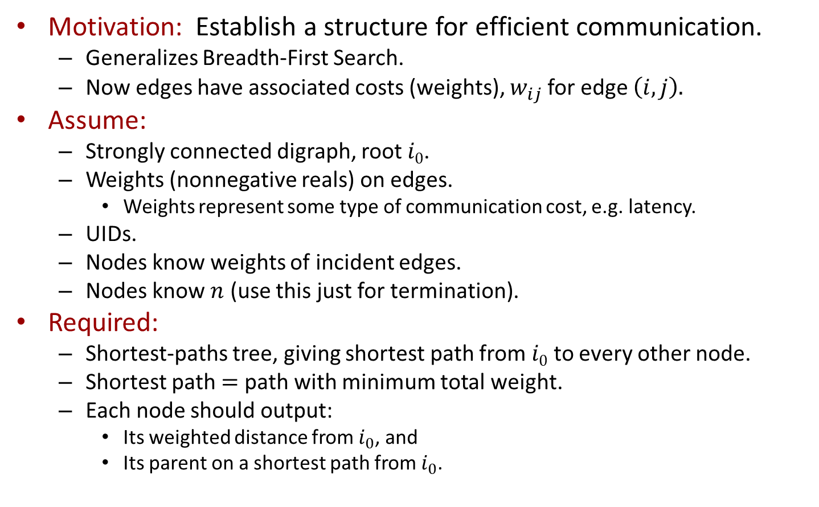
Shortest paths
Motivation: Establish a structure for efficient communication.
Generalizes Breadth-First Search.
Now edges have associated costs (weights), $w_{ij}$for edge $\left(i,j\right).$
Assume:
Strongly connected digraph, root $i0$.
Weights (nonnegative reals) on edges.
Weights represent some type of communication cost, e.g. latency.
UIDs.
Nodes know weights of incident edges.
Nodes know $n$ (use this just for termination).
Required:
Shortest-paths tree, giving shortest path from $i0$ to every other node.
Shortest path $=$ path with minimum total weight.
Each node should output:
Its weighted distance from $i_{0}$, and
Its parent on a shortest path from $i_{0}$.
Notes:
Cost could be a charge to traverse the edge.
Total weight of a path.
Shortest path = path with min total weight.
Mixture of terminology.
Define the weighted distance from one node to another to be the total weight of a shortest path between the nodes.

Slide 88
Shortest paths
7
2
1
10
11
5
1
5
8
6
4
2
3
9
4
3
6

Slide 89
Shortest paths
3
7
2
10
1
10
11
5
1
5
8
6
2
4
0
2
3
9
9
4
3
6
6

Slide 90
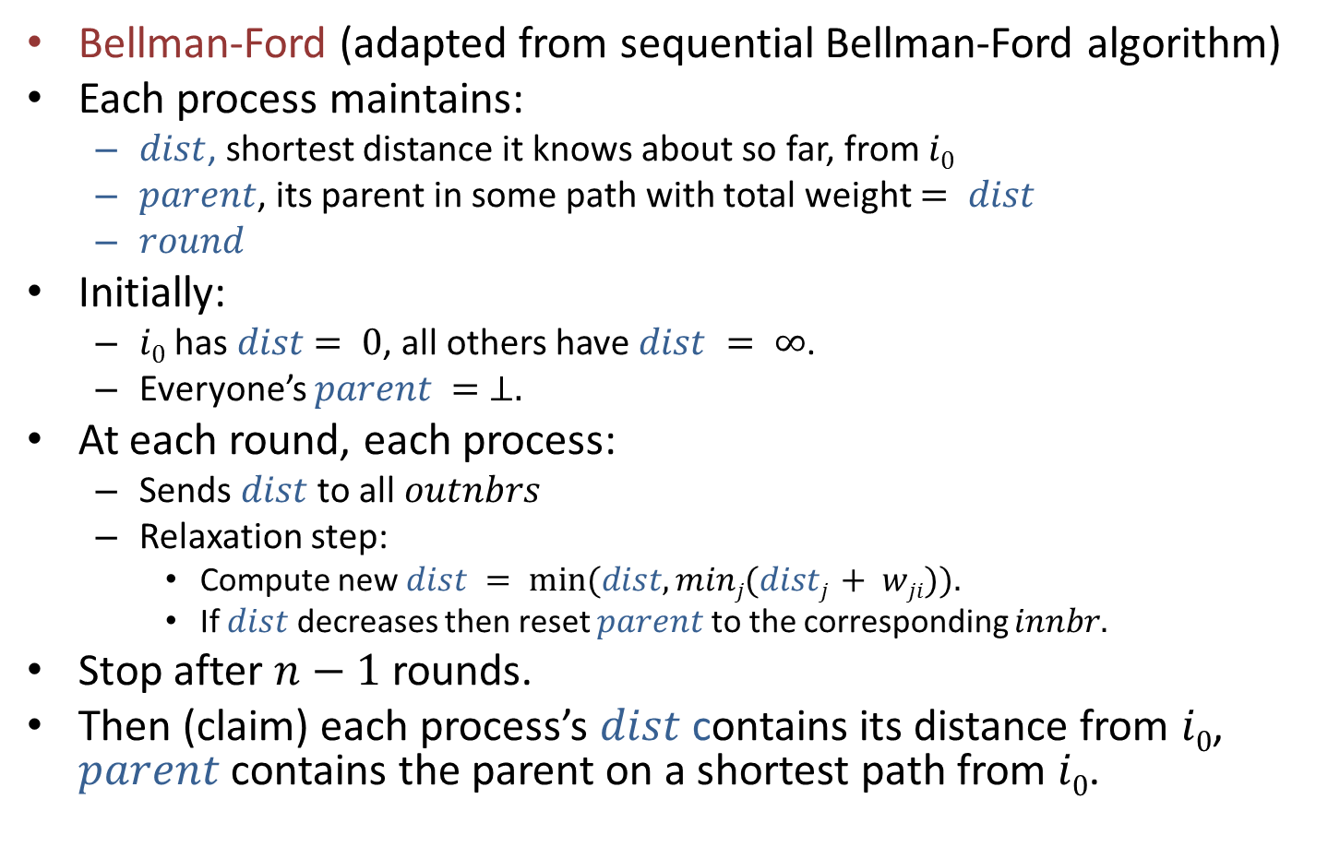
Shortest paths algorithm
Bellman-Ford (adapted from sequential Bellman-Ford algorithm)
Each process maintains:
$dist$, shortest distance it knows about so far, from $i0$
$parent$, its parent in some path with total weight $= dist$
$round$
Initially:
$i0$ has $dist$ $= 0$, all others have $dist = ∞$.
Everyone’s $parent = ⊥.$
At each round, each process:
Sends $dist$ to all $outnbrs$
Relaxation step:
Compute new $dist = min⁡(dist, minj(distj + wji)).$
If $dist$ decreases then reset $parent$to the corresponding $innbr.$
Stop after $n−1$ rounds.
Then (claim) each process’s $dist$ contains its distance from $i0$, $parent$ contains the parent on a shortest path from $i0$.
Notes:
This is called a “relaxation algorithm”.
The min is taken over all in-nbrs.
If dist decreases there is some neighbor whose message caused the decrease. Make that the new parent.

Slide 91
Next time
More distributed algorithms for general synchronous networks:
Shortest paths, Bellman-Ford algorithm, continued
Minimum spanning tree, Gallager-Humblet-Spira algorithm
Maximal independent set, Luby’s algorithm
Readings:
Sections 4.3-4.5.
[Gallager, Humblet, Spira] (optional)
[Luby] (optional)
[Metivier, Robson,…] (optional)

